Slide 1
4.4
Logical Database Design

Slide 2
Relational Database Design Algorithms

Slide 3
Outline
Algorithms for Relational Database Schema Design
Nulls, Dangling Tuples, Alternative Relational Designs
Multivalued Dependencies and Fourth Normal Form – further discussion
Other Dependencies and Normal Forms
Join Dependencies
Inclusion Dependencies
Dependencies based on Arithmetic Functions and Procedures
Domain-Key Normal Form

Slide 4
DESIGNING A SET OF RELATIONS (1)
The Approach of Relational Synthesis (Bottom-up Design):
Assumes that all possible functional dependencies are known.
First constructs a minimal set of FDs
Then applies algorithms that construct a target set of 3NF or BCNF relations.
Additional criteria may be needed to ensure the the set of relations in a relational database are satisfactory
(see Algorithm 15.3).

Slide 5
DESIGNING A SET OF RELATIONS (2)
Goals:
Lossless join property (a must)
Algorithm 15.3 tests for general losslessness.
Dependency preservation property
Observe as much as possible
Algorithm 15.5 decomposes a relation into BCNF components by sacrificing the dependency preservation.
Additional normal forms
4NF (based on multi-valued dependencies)
5NF (based on join dependencies)

Slide 6
Algorithm to determine the key of a relation
Algorithm 15.2a Finding a Key K for R, given a set F of Functional Dependencies
Input: A universal relation R and a set of functional dependencies F on the attributes of R.
1. Set K := R;
2. For each attribute A in K {
Compute (K - A)⁺ with respect to F;
If {K – A}⁺ contains all the attributes in R,
then set K := K - {A};
}

Slide 7
Properties of Relational Decompositions
Relation Decomposition and Insufficiency of Normal Forms:
Universal Relation Schema:
A relation schema R = {A1, A2, …, An} that includes all the attributes of the database.
Universal Relation Assumption:
Every attribute name is unique.
Decomposition:
The process of decomposing the universal relation schema R into a set of relation schemas D = {R1,R2, …, Rm} that will become the relational database schema by using the functional dependencies.
Attribute Preservation Condition:
Each attribute in R will appear in at least one relation schema R_{i} in the decomposition so that no attributes are “lost”.

Slide 8
Properties of Relational Decompositions
Another goal of decomposition is to have each individual relation R_{i} in the decomposition D be in BCNF or 3NF.
Additional properties of decomposition are needed to prevent from generating spurious tuples

Slide 9
Properties of Relational Decompositions
Dependency Preservation Property of a Decomposition
Definition:
Given a set of dependencies F on R, the projection of F on R_{i}, denoted by P_{Ri}(F) where R_{i} is a subset of R,
is the set of dependencies X  Y in F⁺ such that the attributes in X U Y are all contained in R_{i}.
Notes:
Hence, the projection of F on each relation schema R_{i} in the decomposition D is the set of functional dependencies in F⁺, the closure of F, such that all their left- and right-hand-side attributes are in R_{i}.

Slide 10
Properties of Relational Decompositions (cont)
Dependency Preservation Property:
A decomposition D = {R1, R2, ..., Rm} of R is dependency-preserving with respect to F if the union of the projections of F on each Ri in D is equivalent to F; i.e. ((π_{R1}(F)) υ (π_{R2}(F)). . . υ (π_{Rm}(F)))⁺ = F⁺
Claim 1:
It is always possible to find a dependency-preserving decomposition D with respect to F such that each relation R_{i} in D is in 3NF.

Slide 11
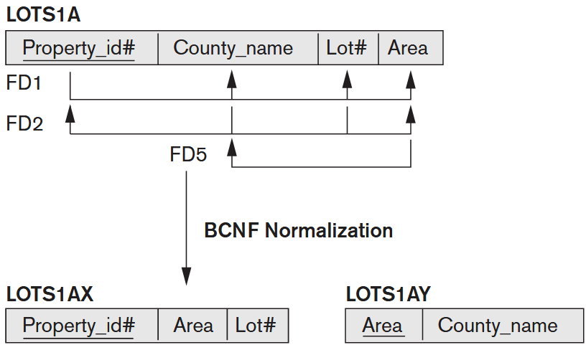
Exercise: Is Dependency Preserved
BCNF normalization of LOTS1A with the functional dependency FD2 being lost in the decomposition.

Slide 12
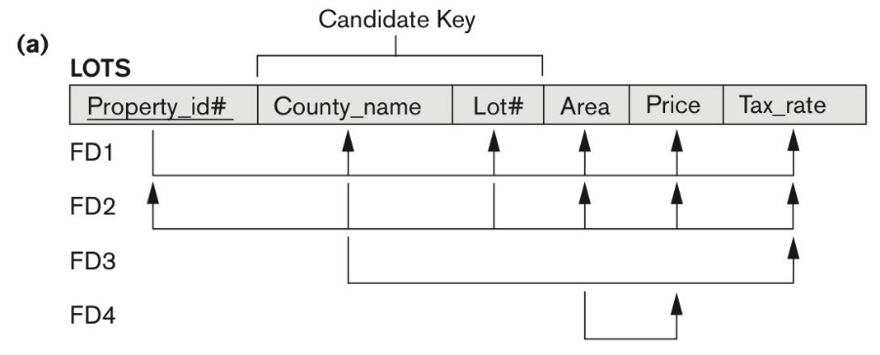
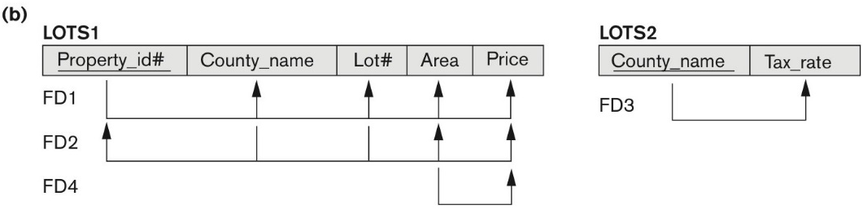
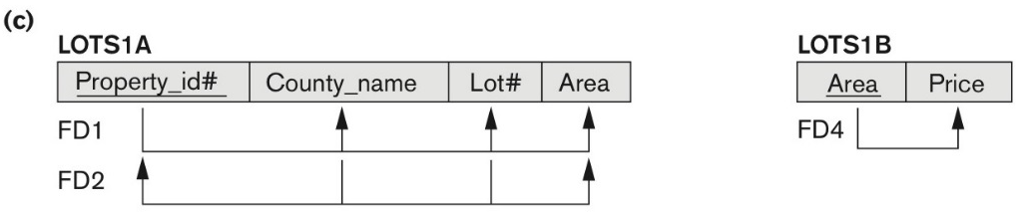
Exercise: Is Dependency Preserved

Slide 13

Exercise: Is Dependency Preserved
TEACH(student, course, Instructor)
FD1: {student, course} -> instructor
FD2: instructor -> course
R1(instructor, course)
Decomposed into
R2(instructor, student)
BCNF normalization of TEACH with the functional dependency FD1 being lost in the decomposition.

Slide 14
Properties of Relational Decompositions
Non-additive (Lossless) Join Property of a Decomposition:
Definition: Lossless join property: a decomposition D = {R₁, R₂, ..., R_{m}} of R has the lossless (nonadditive) join property with respect to the set of dependencies F on R if,
for every relation state r of R that satisfies F, the following holds, where * is the natural join of all the relations in D:
* (π _{R1}(r), ..., π_{Rm}(r)) = r
Note: The word loss in lossless refers to loss of information, not to loss of tuples. In fact, for “loss of information” a better term is “addition of spurious information”

Slide 15
Properties of Relational Decompositions(cont)
Algorithm 15.3: Testing for Lossless Join Property
Input: A universal relation R, a decomposition D = {R₁, R₂, ..., R_{m}} of R, and a set F of functional dependencies.
1. Create an initial matrix S with one row i for each relation R_{i} in D, and one column j for each attribute A_{j} in R.
2. Set S(i, j):= b_{ij} for all matrix entries. (* each b_{ij} is a distinct symbol associated with indices (i, j) *).
3. For each row i representing relation schema R_{i}
{for each column j representing attribute A_{j}
{if (relation R_{i} includes attribute A_{j}) then set S(i, j):= a_{j};};};
(* each a_{j} is a distinct symbol associated with index (j) *)
CONTINUED on NEXT SLIDE

Slide 16
Properties of Relational Decompositions(cont)
Algorithm 15.3: Testing for Lossless Join Property (continued)
4. Repeat the following loop until a complete loop execution results in no changes to S
{for each functional dependency X Y in F
{for all rows in S which have the same symbols in the columns corresponding to attributes in X
{make the symbols in each column that correspond to an attribute in Y be the same in all these rows as follows:
If any of the rows has an “a” symbol for the column, set the other rows to that same “a” symbol in the column.
If no “a” symbol exists for the attribute in any of the rows, choose one of the “b” symbols that appear in one of the rows for the attribute and set the other rows to that same “b” symbol in the column ;};
};
};
5. If a row is made up entirely of “a” symbols, then the decomposition has the lossless join property; otherwise it does not.

Slide 17
Properties of Relational Decompositions (cont)
R = {Ssn, Ename, Pnumber, Pname, Plocation, Hours}
F = {
Ssn→ Ename;
Pnumber→{Pname, Plocation};
{Ssn, Pnumber} →Hours
}
D = {R1, R2 }
R1 = EMP_LOCS = {Ename, Plocation}
R2 = EMP_PROJ1 = {Ssn, Pnumber, Hours, Pname, Plocation}
R | Ssn | Ename | Pnumber | Pname | Plocation | Hours
R1 | b11 | a2 | b13 | b14 | a5 | b16
R2 | a1 | b22 | a3 | a4 | a5 | a6
(No changes to matrix after applying functional dependencies

Slide 18
Properties of Relational Decompositions (cont)
R = {Ssn, Ename, Pnumber, Pname, Plocation, Hours}
F = {Ssn→ Ename; Pnumber→{Pname, Plocation}; {Ssn, Pnumber} →Hours}
R1 = EMP = {Ssn, Ename}
D = {R1, R2, R3 }
R2 = PROJ = {Pnumber, Pname, Plocation}
R2 = PROJ = {Ssn, Pnumber, Hours}
R | Ssn | Ename | Pnumber | Pname | Plocation | Hours
R1 | a1 | a2 | b13 | b14 | b15 | b16
R2 | b21 | b22 | a3 | a4 | a5 | b26
R3 | a1 | b32 | a3 | b34 | b35 | a6
Apply the first two functional dependencies
R | Ssn | Ename | Pnumber | Pname | Plocation | Hours
R1 | a1 | a2 | b13 | b14 | b15 | b16
R2 | b21 | b22 | a3 | a4 | a5 | b26
R3 | a1 | B32 a2 | a3 | B34 a4 | B35 a5 | a6
Last row is all “a” symbols so we stop

Slide 19
Test for checking non-additivity of Binary Relational Decompositions (cont)
Testing Binary Decompositions for Non-additive Join (Lossless Join) Property
Binary Decomposition: Decomposition of a relation R into two relations.
PROPERTY NJB (non-additive join test for binary decompositions): A decomposition D = {R1, R2} of R has the lossless join property with respect to a set of functional dependencies F on R if and only if either
The f.d. ((R1 ∩ R2)  (R1- R2)) is in F⁺, or
The f.d. ((R1 ∩ R2)  (R2 - R1)) is in F⁺.

Slide 20
Properties of Relational Decompositions
Successive Non-additive Join Decomposition
Claim 2 (Preservation of non-additivity in successive decompositions):
If a decomposition D = {R1, R2, ..., Rm} of R has the lossless (non-additive) join property with respect to a set of functional dependencies F on R, and
if a decomposition Di = {Q1, Q2, ..., Qk} of Ri has the lossless (non-additive) join property with respect to the projection of F on Ri,
then the decomposition D2 = {R1, R2, ..., Ri-1, Q1, Q2, ..., Qk, Ri+1, ..., Rm} of R has the non-additive join property with respect to F.

Slide 21
Algorithms for Relational Database Schema Design (1)
Design of 3NF Schemas:
Algorithm: Relational Synthesis into 3NF with Dependency Preservation and Non-Additive (Lossless) Join Property
Input: A universal relation R and a set of functional dependencies F on the attributes of R.
1. Find a minimal cover G for F (use Algorithm 15.0).
2. For each left-hand-side X of a functional dependency that appears in G,
create a relation schema in D with attributes {X υ {A1} υ {A2} ... υ {Ak}},
where X  A1, X  A2, ..., X –>Ak are the only dependencies in G with X as left-hand-side (X is the key of this relation).
3. If none of the relation schemas in D contains a key of R, then create one more relation schema in D that contains attributes that form a key of R. (Use Algorithm 15.2a to find the key of R)

Slide 22
Algorithms for Relational Database Schema Design (2)
Design of BCNF Schemas
Algorithm 15.5: Relational Decomposition into BCNF with Lossless (non-additive) join property
Input: A universal relation R and a set of functional dependencies F on the attributes of R.
1. Set D := {R};
2. While there is a relation schema Q in D that is not in BCNF
do {
choose a relation schema Q in D that is not in BCNF;
find a functional dependency X  Y in Q that violates BCNF;
replace Q in D by two relation schemas (Q - Y) and (X U Y);
};
Assumption: No null values are allowed for the join attributes.

Slide 23
Problems with Null Values and Dangling Tuples (1)
4.1 Problems with NULL values
when some tuples have NULL values for attributes that will be used to join individual relations in the decomposition that may lead to incomplete results.
E.g., see Figure 15.2(a), where two relations EMPLOYEE and DEPARTMENT are shown. The last two employee tuples—‘Berger’ and ‘Benitez’—represent newly hired employees who have not yet been assigned to a department (assume that this does not violate any integrity constraints).
If we want to retrieve a list of (Ename, Dname) values for all the employees. If we apply the NATURAL JOIN operation on EMPLOYEE and DEPARTMENT (Figure 15.2(b)), the two aforementioned tuples will not appear in the result.
In such cases, LEFT OUTER JOIN may be used. The result is shown in Figure 15.2 (c).

Slide 24
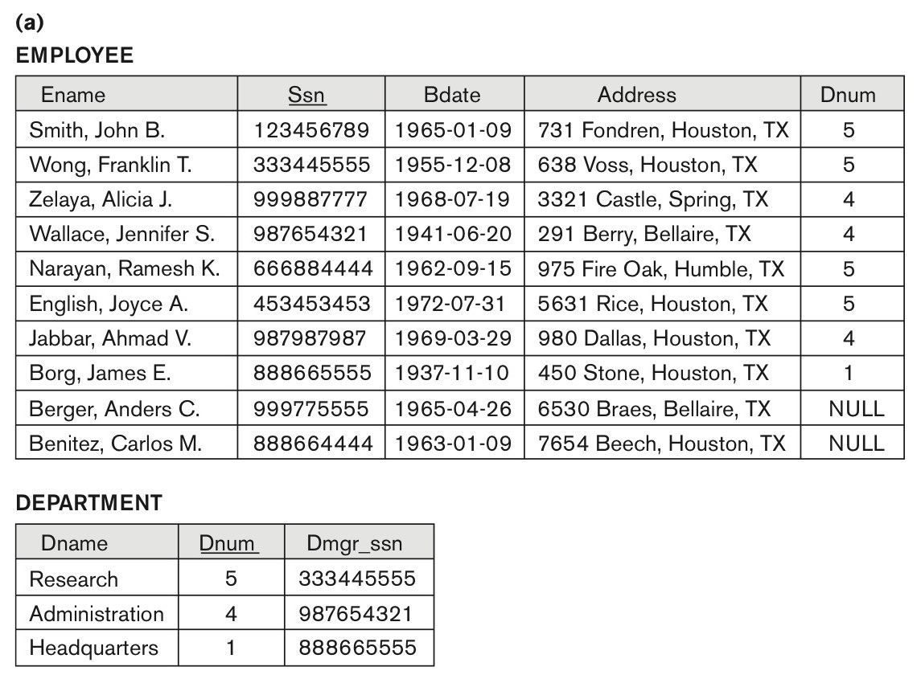
Problems with Null Values and Dangling Tuples (2)
Some EMPLOYEE tuples have NULL for the join attribute Dnum.

Slide 25
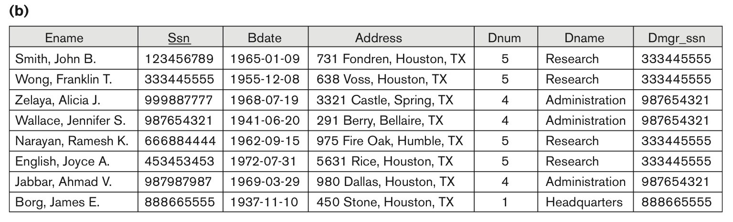
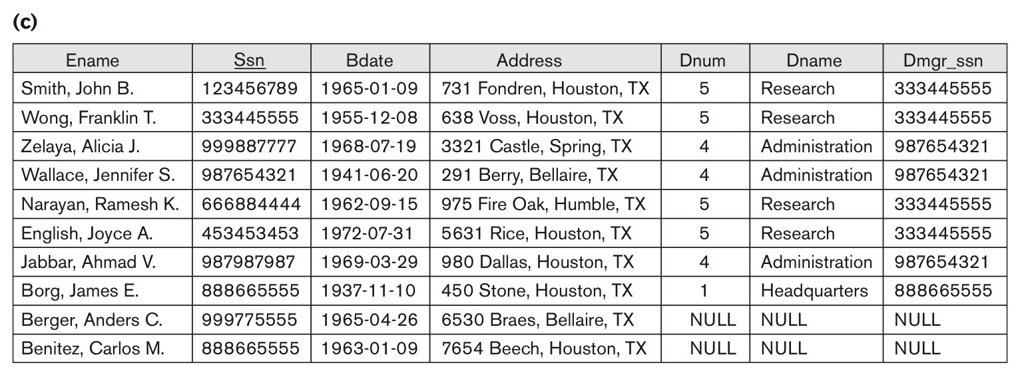
Problems with Null Values and Dangling Tuples (3)
Result of applying NATURAL JOIN to the EMPLOYEE and DEPARTMENT relations.
Result of applying LEFT OUTER JOIN to EMPLOYEE and DEPARTMENT

Slide 26
Problems with Null Values and Dangling Tuples (4)
Problems with Dangling Tuples
Consider the decomposition of EMPLOYEE into EMPLOYEE_1 and EMPLOYEE_2 as shown in Figure 15.3 (a) and !5.3 (b).
Their NATURAL JOIN yields the original relation EMPLOYEE in Figure 15.2(a).
We may use the alternative representation, shown in Figure 15.3(c), where we do not include a tuple in EMPLOYEE_3 if the employee has not been assigned a department (instead of including a tuple with NULL for Dnum as in EMPLOYEE_2).
If we use EMPLOYEE_3 instead of EMPLOYEE_2 and apply a NATURAL JOIN on EMPLOYEE_1 and EMPLOYEE_3, the tuples for Berger and Benitez will not appear in the result; these are called dangling tuples in EMPLOYEE.

Slide 27
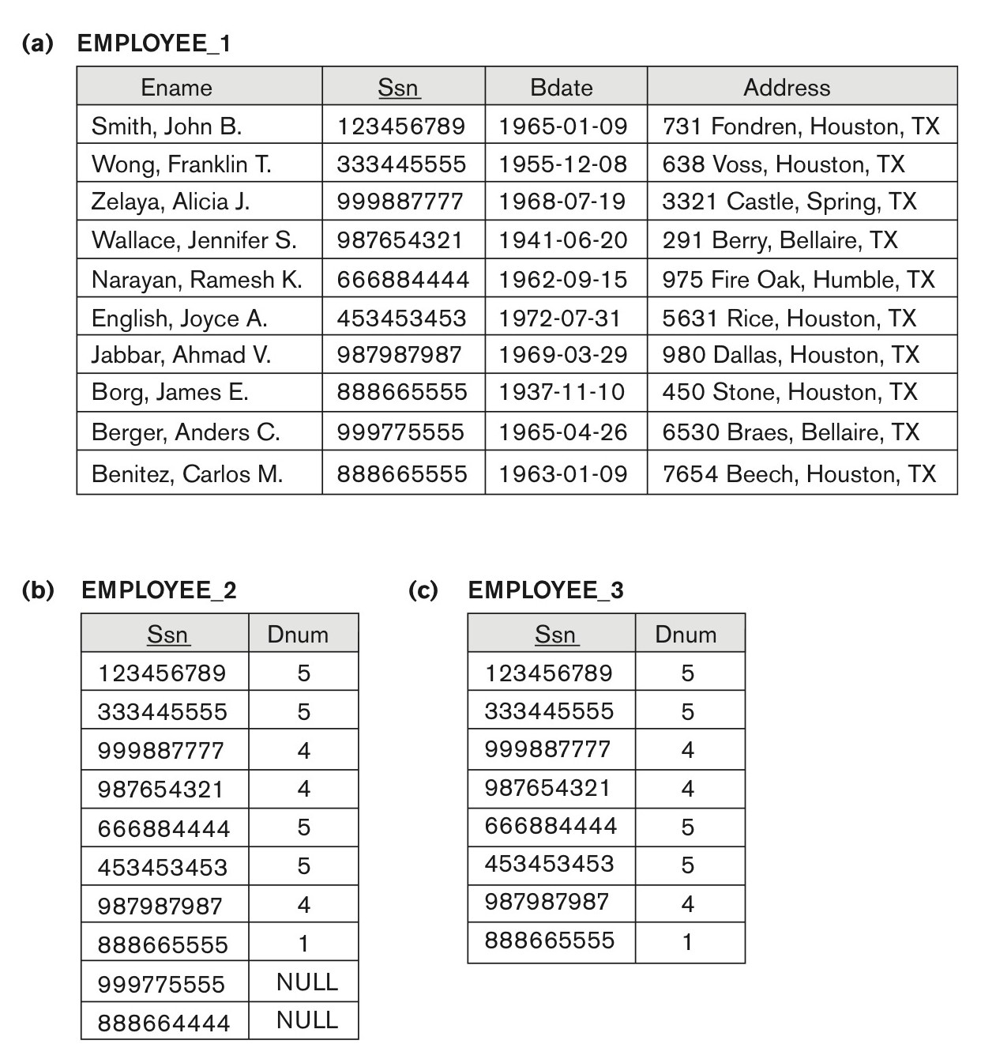
Problems with Null Values and Dangling Tuples (5)
The relation EMPLOYEE_1 (includes all attributes of EMPLOYEE from Figure 15.2(a) except Dnum).
(b) The relation EMPLOYEE_2 (includes Dnum attribute with NULL values).
(c) The relation EMPLOYEE_3 (includes Dnum attribute but does not include tuples for which Dnum has NULL values).

Slide 28
About Normalization Algorithms
Discussion of Normalization Algorithms:
Problems:
The database designer must first specify all the relevant functional dependencies among the database attributes.
These algorithms are not deterministic in general.
It is not always possible to find a decomposition into relation schemas that preserves dependencies and allows each relation schema in the decomposition to be in BCNF (instead of 3NF as in Algorithm 15.5).

Slide 29
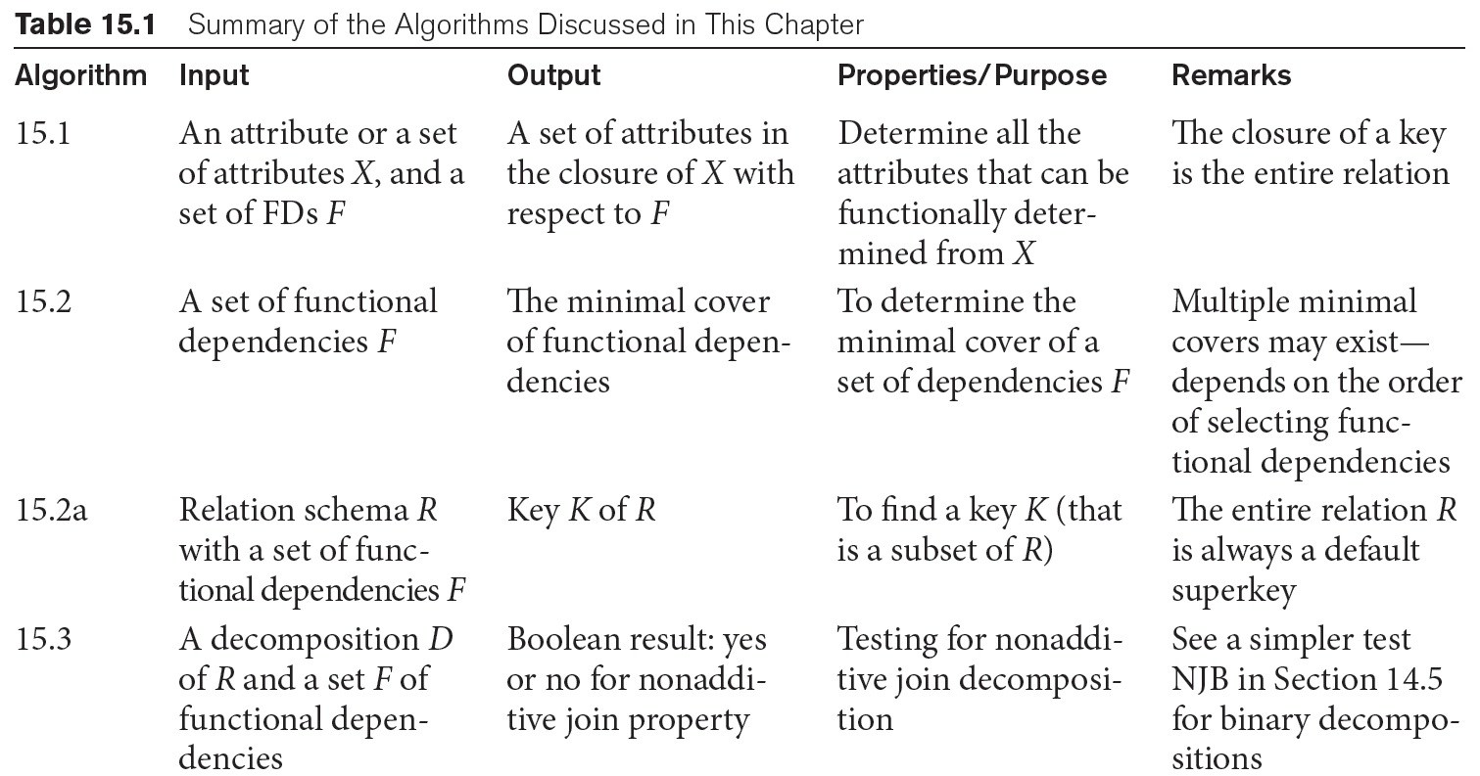
Summary of Algorithms for Relational Database Schema Design (1)

Slide 30
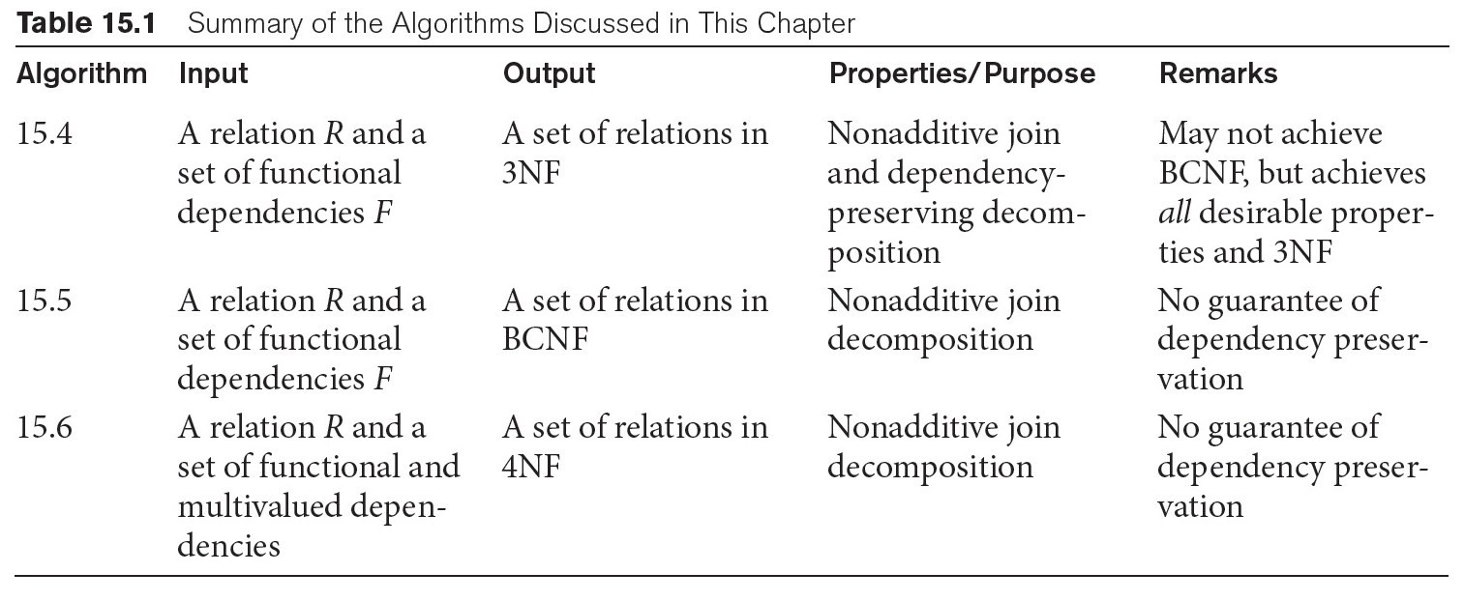
Summary of Algorithms for Relational Database Schema Design (2)

Slide 31
5. Multivalued Dependencies and Fourth Normal Form – Further Discussion (1)
Definition:
A multivalued dependency (MVD) X —>> Y specified on relation schema R, where X and Y are both subsets of R, specifies the following constraint on any relation state r of R: If two tuples t₁ and t₂ exist in r such that t₁[X] = t₂[X], then two tuples t₃ and t₄ should also exist in r with the following properties, where we use Z to denote (R 2 (X υ Y)):
t₃[X] = t₄[X] = t₁[X] = t₂[X].
t₃[Y] = t₁[Y] and t₄[Y] = t₂[Y].
t₃[Z] = t₂[Z] and t₄[Z] = t₁[Z].
An MVD X —>> Y in R is called a trivial MVD if (a) Y is a subset of X, or (b) X υ Y = R.

Slide 32
Multivalued Dependencies and Fourth Normal Form (2)
Inference Rules for Functional and Multivalued Dependencies:
IR1 (reflexive rule for FDs): If X ⊇ Y, then X → Y.
IR2 (augmentation rule for FDs): {X → Y} ⏐= XZ → YZ.
IR3 (transitive rule for FDs): {X → Y, Y → Z} ⏐= X → Z.
IR4 (complementation rule for MVDs): {X —>> Y} ⏐= X —>> (R – (X ∪ Y))}.
IR5 (augmentation rule for MVDs): If X —>> Y and W ⊇ Z then WX —>> YZ.
IR6 (transitive rule for MVDs): {X —>> Y, Y —>> Z} ⏐= X —>> (Z - Y).
IR7 (replication rule for FD to MVD): {X –> Y} ⏐= X —>> Y.
IR8 (coalescence rule for FDs and MVDs): If X —>> Y and there exists W with the properties that
(a) W ∩ Y is empty, (b) W –> Z, and (c) Y ⊇ Z, then X –> Z.

Slide 33
Multivalued Dependencies and Fourth Normal Form (3)
Definition:
A relation schema R is in 4NF with respect to a set of dependencies F (that includes functional dependencies and multivalued dependencies) if,
for every nontrivial multivalued dependency X —>> Y in F⁺, X is a superkey for R.
Note: F⁺ is the (complete) set of all dependencies (functional or multivalued) that will hold in every relation state r of R that satisfies F. It is also called the closure of F.

Slide 34
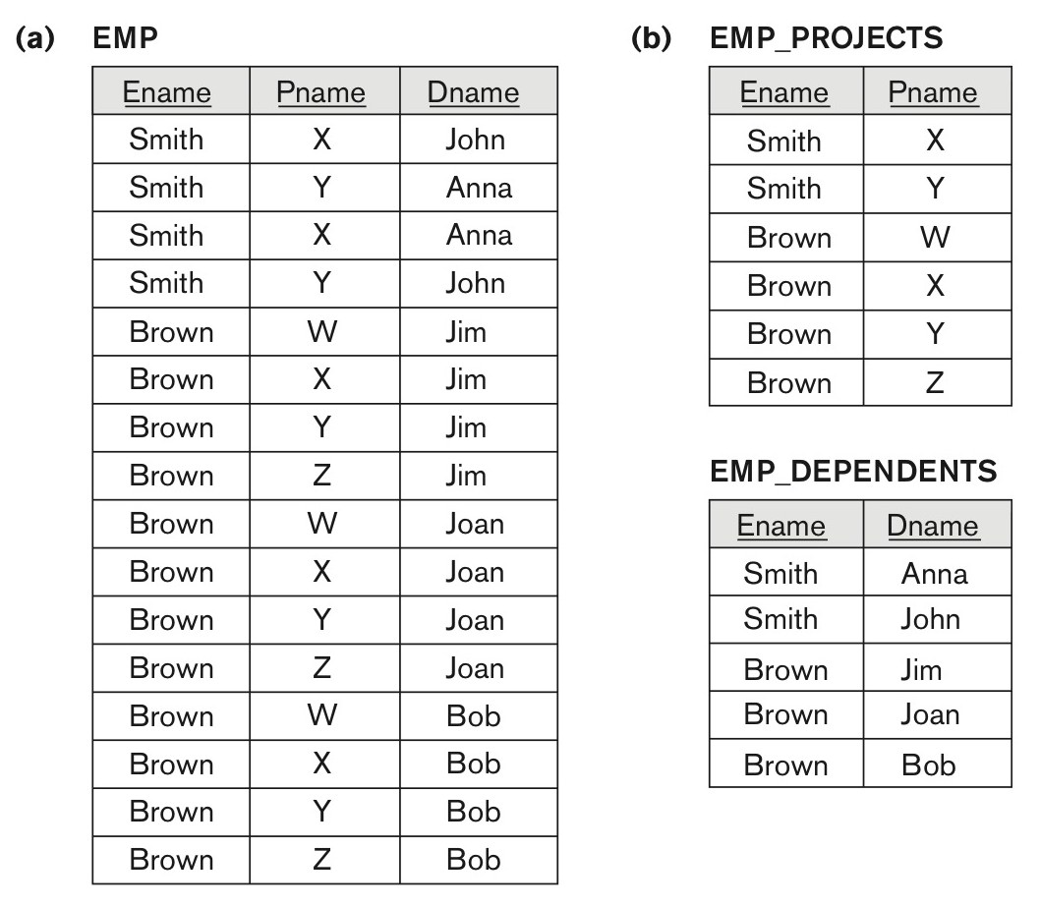
Multivalued Dependencies and Fourth Normal Form (4)
Decomposing a relation state of EMP that is not in 4NF.
(a) EMP relation with additional tuples.
(b) Two corresponding 4NF relations EMP_PROJECTS and EMP_DEPENDENTS.

Slide 35
Multivalued Dependencies and Fourth Normal Form (5)
5.3 Non-additive( Lossless) Join Decomposition into 4NF Relations:
PROPERTY NJB’
The relation schemas R₁ and R₂ form a lossless (non-additive) join decomposition of R with respect to a set F of functional and multivalued dependencies if and only if
(R₁ ∩ R₂) —>> (R₁ - R₂)
or by symmetry, if and only if
(R₁ ∩ R₂) —>> (R₂ - R₁)).

Slide 36
Multivalued Dependencies and Fourth Normal Form (6)
Algorithm 15.7: Relational decomposition into 4NF relations with non-additive join property
Input: A universal relation R and a set of functional and multivalued dependencies F.
Set D := { R };
While there is a relation schema Q in D that is not in 4NF do {
choose a relation schema Q in D that is not in 4NF;
find a nontrivial MVD X —>> Y in Q that violates 4NF;
replace Q in D by two relation schemas (Q - Y) and (X ∪ Y);
};

Slide 37
Other Dependencies and Normal Forms
Definition (Chapter 14):
A join dependency (JD), denoted by JD(R₁, R₂, ..., R_{n}), specified on relation schema R, specifies a constraint on the states r of R.
The constraint states that every legal state r of R should have a non-additive join decomposition into R₁, R₂, ..., R_{n}; that is, for every such r we have * (π_{R1}(r), π_{R2}(r), ..., π_{Rn}(r)) = r
Note: an MVD is a special case of a JD where n = 2.
A join dependency JD(R₁, R₂, ..., R_{n}), specified on relation schema R, is a trivial JD if one of the relation schemas R_{i} in JD(R₁, R₂, ..., R_{n}) is equal to R.

Slide 38
Join Dependencies and Fifth Normal Form
Definition of 5NF:
A relation schema R is in fifth normal form (5NF) (or Project-Join Normal Form (PJNF)) with respect to a set F of functional, multivalued, and join dependencies if,
for every nontrivial join dependency JD(R₁, R₂, ..., R_{n}) in F⁺ (that is, implied by F),
every R_{i} is a superkey of R.
Discovering join dependencies in practical databases with hundreds of relations is next to impossible. Therefore, 5NF is rarely used in practice.

Slide 39
Inclusion Dependencies (1)
Definition:
An inclusion dependency R.X < S.Y between two sets of attributes
X of relation schema R, and Y of relation schema S
specifies the constraint that, at any specific time when r is a relation state of R and s a relation state of S, we must have π_{X}(r(R)) ⊆ π_{Y}(s(S))
Note:
The ⊆ (subset) relationship does not necessarily have to be a proper subset.
The sets of attributes on which the inclusion dependency is specified (X of R and Y of S) must have the same number of attributes.
In addition, the domains for each pair of corresponding attributes should be compatible.

Slide 40
Inclusion Dependencies (2)
Objective of Inclusion Dependencies:
To formalize two types of inter-relational constraints which cannot be expressed using F.D.s or MVDs:
Referential integrity constraints
Class/subclass relationships
Inclusion dependency inference rules
IDIR1 (reflexivity): R.X < R.X.
IDIR2 (attribute correspondence): If R.X < S.Y
where X = {A₁, A₂ ,..., A_{n}} and Y = {B₁, B₂, ..., B_{n}} and A_{i} Corresponds-to B_{i}, then R.A_{i} < S.B_{i}
for 1 ≤ i ≤ n.
IDIR3 (transitivity): If R.X < S.Y and S.Y < T.Z, then R.X < T.Z.

Slide 41
Functional Dependencies based on Arithmetic functions and procedures (1)
Arithmetic Functions:
As long as a unique value of Y is associated with every X, we can still consider that the FD X → Y exists.
For example, consider the relation:
ORDER_LINE (Order#, Item#, Quantity, Unit_price, Extended_price, Discounted_price)
each tuple represents an item from an order with a particular quantity, and the price per unit for that item. In this relation,
(Quantity, Unit_price ) → Extended_price by the formula
Extended_price = Quantity * Unit_price .
Hence, there is a unique value for Extended_price for every pair (Quantity, Unit_price ), and thus it conforms to the definition of functional dependency.

Slide 42
Functional Dependencies based on Arithmetic functions and procedures (2)
Procedures:
There may be a procedure that takes into account the quantity discounts, the type of item, and so on and computes a discounted price for the total quantity ordered for that item. Therefore, we can say
(Item#, Quantity, Unit_price ) → Discounted_price, or
(Item#, Quantity, Extended_price) → Discounted_price.

Slide 43
Other Dependencies and Normal Forms (3)
Domain-Key Normal Form (DKNF):
Definition:
A relation schema is said to be in DKNF if all constraints and dependencies that should hold on the valid relation states can be enforced simply by enforcing the domain constraints and key constraints on the relation.
The idea is to specify (theoretically, at least) the “ultimate normal form” that takes into account all possible types of dependencies and constraints.
For a relation in DKNF, it becomes very straightforward to enforce all database constraints by simply checking that each attribute value in a tuple is of the appropriate domain and that every key constraint is enforced.
The practical utility of DKNF is limited

Slide 44
Recap
Designing a Set of Relations by Synthesis
Properties of Relational Decompositions
Algorithms for Relational Database Schema Design in 3Nf and BCNF
Multivalued Dependencies and Fourth Normal Form
Other Dependencies and Normal Forms

